Slide 1
3. Conditional probability

Slide 2
Contents
Conditional probability
Bayes’s Formula
Independent Events
P(A|F) Is a Probability

Slide 3
Coins game ----understand conditional probability
Toss 3 coins. You win if at least two come out heads
S = { HHH, HHT, HTH, HTT, THH, THT, TTH, TTT }
equally likely outcomes
W = { HHH, HHT, HTH, THH }
P(W) = |W|/|S| = 1/2

Slide 4
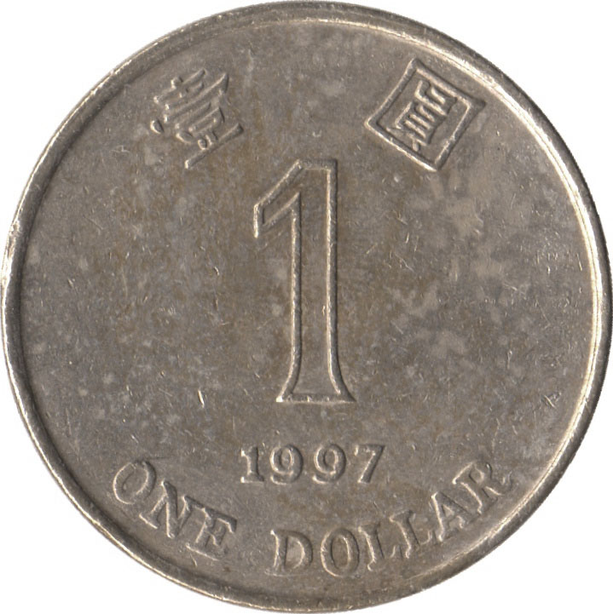
Coins game ----understand conditional probability
The first coin was just tossed and it came out
tails. How does this affect your chances?
S = { HHH, HHT, HTH, HTT, THH, THT, TTH, TTT }
equally likely outcomes
reduced sample
space F
W = { HHH, HHT, HTH, THH }
P(W | F)
= |W F|/|F|
= 1/4

Slide 5


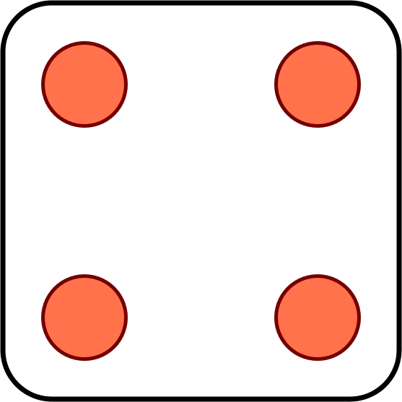

Problem for you to solve
Toss 2 dice. You win if the sum of the outcomes is 8.
The first die comes out to a 4. Should you be happy?
?
Now suppose you win if the sum is 7. Your first toss is a 4. Should you be happy?

Slide 6
Conditional probability
F
The conditional probability P(A | F) represents the probability of event A assuming event F happened.
S
A
Conditional probabilities with respect to the reduced sample space F are given by the formula
P(AF)
P(A | F) =
P(F)

Slide 7
Example 3.1
A box contains 3 cards. One is black on both sides. One is red on both sides. One is black on one side and red on the other.
You draw a random card and see a black side. What are the chances the other side is red?
A: 1/4
B: 1/3
C: 1/2

Slide 8
Solution
B1
B2
B3
S = { F1, B1, F2, B2, F3, B3 }
F1
F2
F3
equally likely outcomes
The event you see a black side is SB = { F1, B1, F3 }
The event the other side is red is OR = { F2, B2, F3 }
P(OR SB)
1/|S|
P(OR | SB) =
=
= 1/3
P(SB)
3/|S|

Slide 9
The multiplication rule
P(E₁E₂)
Using the formula
P(E₂|E₁) =
P(E₁)
We can calculate the probability of intersection
P(E₁E₂) = P(E₁) P(E₂|E₁)
In general for n events
P(E₁E₂…E_{n}) = P(E₁) P(E₂|E₁)…P(E_{n}|E₁…E_{n-1})

Slide 10
Example 3.2 Using conditional probabilities
There are 8 red balls and 8 blue balls in an urn. You draw at random without replacement. What is the probability the first two balls are red?
Solution 1: without conditional probabilities
S = arrangements of r red and b blue balls
E = arrangements in which the first two are red
|E|
14! / (6! 8!)
8 ∙ 7
P(E) =
=
=
|S|
16! / (8! 8!)
16 ∙ 15

Slide 11
Example 3.2 Using conditional probabilities
Solution 2: using conditional probabilities
R₁ = arrangements in which the first ball is red
R₂ = arrangements in which the second ball is red
P(R₁R₂) = P(R₁) P(R₂|R₁)
P(R₁) = 8/16
Given the first ball is red, we are left with 7 red and 8 blue balls under equally likely outcomes
P(R₂|R₁) = 7/15
P(R₁R₂) = P(R₁) P(R₂|R₁)
= (8/16) (7/15)

Slide 12
Example 3.3 Cards
You divide 52 cards evenly among 4 people. What is the probability everyone gets an ace?
S = all ways to divide 52 cards among 4 people
equally likely outcomes
E = everyone gets an ace
= A♠ A♣ A♥ A♦ are assigned to different people
E₃ = A♣ A♥ A♦ are all assigned to different people
E₂ = A♥ A♦ are all assigned to different people
P(E) = P(E₂) P(E₃|E₂) P(E|E₂E₃)

Slide 13
Example 3.3 Cards
E₂ = A♥ A♦ are assigned to different people
After assigning A♥ it looks like this:
?
?
?
?
?
?
?
?
?
?
?
?
?
?
?
?
?
?
?
?
?
?
?
?
?
?
?
?
?
?
?
?
?
?
A♥
?
?
?
?
?
?
?
?
?
?
?
?
?
?
?
?
?
P(E₂) =
# grey cards
= 3 ∙ 13/(52 – 1) = 39/51
# of question marks

Slide 14
Example 3.3 Cards
E₃ = A♣ A♥ A♦ are all assigned to different people
After E₂ it looks like this:
?
?
?
A♦
?
?
?
?
?
?
?
?
?
?
?
?
?
?
?
?
?
?
?
?
?
?
?
?
?
?
?
?
?
?
A♥
?
?
?
?
?
?
?
?
?
?
?
?
?
?
?
?
?
P(E₃|E₂) = 2 ∙ 13/(52 – 2) = 26/50

Slide 15
Example 3.3 Cards
E₂ = A♥ A♦ are assigned to different people
P(E₂) = 3 ∙ 13/(52 – 1) = 39/51
E₃ = A♣ A♥ A♦ are all assigned to different people
P(E₃ | E₂) = 2 ∙ 13/(52 – 2) = 26/50
E = A♠ A♣ A♥ A♦ all assigned to different people
P(E | E₃) = 13/(52 – 3) = 13/49
P(E) = (39/51) (26/50) (13/49) ≈ .105

Slide 16
Rule of average conditional probabilities
F
F^{c}
P(E)
= P(EF) + P(EF^{c})
S
E
= P(E|F)P(F) + P(E|F^{c})P(F^{c})
Law of total probability (LOTP)
F₃
F₁
F₄
More generally, if F₁,…, F_{n}
partition S then
E
F₂
F₅
P(E) = P(E|F₁)P(F₁) + … + P(E|F_{n})P(F_{n})

Slide 17
Example 3.4 Multiple choice
What is the capital of Macedonia?
A: Split
B: Struga
C: Skopje
D: Sarajevo
Did you know or were you lucky? Namely,
The probability that one know the answer

Slide 18
Multiple choice test
Probability model
There are two types of students:
Type K: Knows the answer
Type K^{c}: Picks a random answer
Event C: Student gives correct answer
P(C) = p = fraction of correct answers
p = P(C|K)P(K) + P(C|K^{c})P(K^{c})
= 1/4 + 3P(K)/4
1
1/4
1 - P(K)
P(K) = (p – ¼) / ¾

Slide 19
Example 3.5 Red and blue balls again
There are 8 red balls and 6 blue balls in an urn. You draw at random without replacement. What is the probability the first two balls are of the same color?
event E
Solution:
Let R₁ be the event “the first ball is red”
R₂ be “the second ball is red”
P(E) = P(E|R₁)P(R₁) + P(E|R₁^{c})P(R₁^{c})
= P(R₂|R₁)P(R₁) + P(R₂^{c}|R₁^{c})P(R₁^{c})
= 86/182
7/13
8/14
5/13
6/14

Slide 20
Exercise Boxes
1
2
3
I choose a cup at random and then a random ball from that cup.
What is the probability the ball you draws is blue?

Slide 21
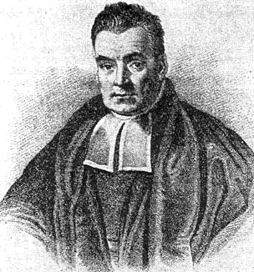
2.2 Bayes’s Formula
P(E|F) P(F)
P(E|F) P(F)
P(F|E) =
=
P(E)
P(E|F) P(F) + P(E|F^{c}) P(F^{c})
More generally, if F₁,…, F_{n} partition S then
P(E|F_{i}) P(F_{i})
P(F_{i}|E) =
P(E|F₁) P(F₁) + … + P(E|F_{n}) P(F_{n})
Result ->reason using bayes
Reason->result using conditional probability

Slide 22
Example 3.5 Boxes
1
2
3
I choose a cup at random and then a random ball from that cup. The ball is blue. You need to guess where the ball came from.

Slide 23
Example 3.5 Boxes
Solution:
1
2
22
3
32
11
21
31
34
12
23
33
P(CUP_{i}|BLUE) = P(CUP_{i} BLUE) / P(BLUE)
P(CUP_{i} BLUE) = P(BLUE | CUP_{i} ) P(CUP_{i})
i
1
2
3
1/3
1/2
2/3
3/4
P(BLUE) = 1/2 1/3 + 2/3 1/3 + 3/4 1/3 = 23/36

Slide 24
Example 3.6 Medical tests
If you are sick (S), a blood test comes out positive (P) 95% of the time.
If you are not sick, the test is positive 1% of the time.
Suppose 0.5% people in China are sick.
You take the test and come out positive. What are the chances that you are sick?
P(P|S) P(S)
P(S|P) =
≈ 32.3%
P(P|S) P(S) + P(P|S^{c}) P(S^{c})
95% 0.5%
1% 99.5%

Slide 25
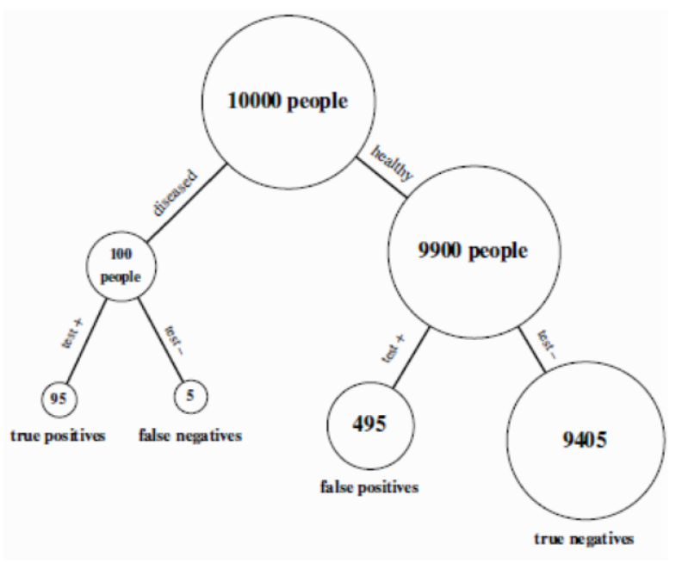
Example 3.6 Explain

Slide 26

Exercise
An insurance company believes that people can be divided into two classes: those who are accident prone and those who are not. The company’s statistics show that an accident-prone person will have an accident at some time within a fixed 1-year period with probability .4, whereas this probability decreases to .2 for a person who is not accident prone. If we assume that 30 percent of the population is accident prone, what is the probability that a new policyholder will have an accident within a year of purchasing a policy?
Notes:
Example 3a

Slide 27


Example 3.7 Russian roulette
Alice
Bob
BANG
Alice and Bob take turns spinning the 6 hole cylinder and shooting at each other.
What is the probability that Alice wins (Bob dies)?

Slide 28
Example 3.7 Russian roulette
Probability model
S = { H, MH, MMH, MMMH, MMMH, …}
E.g. MMH: Alice misses, then Bob misses, then Alice kills
A = “Alice wins” = { H, MMH, MMMMH, …}
outcomes are not equally likely!

Slide 29
Example 3.7 Russian roulette
outcome H MH MMH MMMH MMMMH
probability
1/6
5/6 ∙ 1/6
(5/6)² ∙ 1/6
(5/6)³ ∙ 1/6
(5/6)⁴ ∙ 1/6
P(A)
= 1/6 + (5/6)² ∙ 1/6 + (5/6)⁴ ∙ 1/6 + …
= 1/6 ∙ (1 + (5/6)² + (5/6)⁴ + …)
= 1/6 ∙ 1/(1 – (5/6)²)
= 6/11

Slide 30
Example 3.7 Russian roulette
Solution using conditional probabilities:
A = “Alice wins” = { H, MMH, MMMMH, …}
A^{c} = “Bob wins” = { MH, MMMH, MMMMMH, …}
W₁ = “Alice wins in first round” = { H }
P(A) = P(A|W₁) P(W₁) + P(A|W₁^{c}) P(W₁^{c})
1
1/6
P(A^{c})
5/6
P(A) = 1 ∙ 1/6 + (1 – P(A)) ∙ 5/6
11/6 P(A) = 1
so P(A) = 6/11

Slide 31
Infinite sample spaces
Axioms of probability:
1. for every E, 0 ≤ P(E) ≤ 1
S
E
2. P(S) = 1
S
3. If EF = ∅ then
S
P(E∪F) = P(E) + P(F)
E
F
3. If E₁, E₂, … are pairwise disjoint:
P(E₁∪E₂∪…) = P(E₁) + P(E₂) + …

Slide 32
Exercise
Charlie tosses a pair of dice. Alice wins if the sum is 7. Bob wins if the sum is 8.
Charlie keeps tossing until one of them wins.
What is the probability that Alice wins?

Slide 33
2.3 Independent Events
Let E₁ be “first coin comes up H”
E₂ be “second coin comes up H”
Then P(E₂ | E₁) = P(E₂)
P(E₂E₁) = P(E₂)P(E₁)
Events A and B are independent if
P(A B) = P(A) P(B)
Independence is completely diﬀerent from disjointness
Disjointness: P(AB)=0

Slide 34
Algebra of independent events
If A and B are independent, then A and B^{c} are also independent.
Proof: Assume A and B are independent.
P(B^{c} | A)
= 1 – P(B | A)
= 1 – P(B)
= P(B^{c})
so B^{c} and A are independent.
Taking complements preserves independence.

Slide 35

Examples of (in)dependence
Let E₁ be “first die is a 4”
S₆ be “sum of dice is a 6”
S₇ be “sum of dice is a 7”
P(E₁) = 1/6
P(E₁S₆) = 1/36
E₁, S₆ are dependent
P(S₆) = 5/36
P(S₇) = 1/6
P(E₁S₇) = 1/36
E₁, S₇ are independent
P(S₆S₇) = 0
S₆, S₇ are dependent

Slide 36


Example 3.8 Reliability of sequential components
SWU
Jinyun
Jiayue
Airport
W_{JYT}: “Jinyun tunnel is operational”
P(W_{JYT}) = 90%
W_{JYB}: “Jiayue bridge is operational”
P(W_{JYB}) = 98%
W: “The road is operational”
Assuming events W_{JYT} and W_{JYB} are independent:
P(W) = P(W_{JYT} W_{JYB}) = P(W_{JYT})P(W_{JYB}) = 88.2%

Slide 37

Example 3.9 Reliability of parallel components
Two cars go to Shapingba station in different ways:
85%
Kuaisu
95%
Shapingba station
SWU
Raocheng
Assuming W_{RC} and W_{KS} are independent:
P(W) = P(W_{RC}∪W_{KS})
P(W^{c}) = P(W_{RC}^{c}W_{KS}^{c}) = P(W_{RC}^{c})P(W_{KS}^{c})
P(W) = 1 – P(W_{RC}^{c})P(W_{KS}^{c}) = 1 – 15% 5% = 99.25%

Slide 38
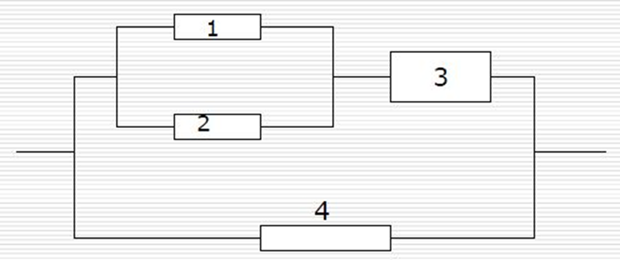
Exercise
A electronic system as follows: each component’s reliability is p

Slide 39
Independence of three events
Events A, B, and C are independent if
P(AB) = P(A) P(B)
P(BC) = P(B) P(C)
P(AC) = P(B) P(C)
and P(ABC) = P(A) P(B) P(C).
This is important!

Slide 40
(In)dependence of three events
Let E₁ be “first die is a 4”
E₂ be “second die is a 3”
S₇ be “sum of dice is a 7”
✔
P(E₁E₂) = P(E₁) P(E₂)
1/6
✔
E₁
P(E₁S₇) = P(E₁) P(S₇)
✔
P(E₂S₇) = P(E₂) P(S₇)
1/36
E₂
S₇
✗
P(E₁E₂S₇) = P(E₁) P(E₂) P(S₇)
1/6
1/6
1/36
1/6
1/6
1/6

Slide 41
Independence of many events
Events A₁, A₂, … are independent if for every subset A_{i1}, …, A_{ir} of the events
P(A_{i1}…A_{ir}) = P(A_{i1}) … P(A_{ir})
Algebra of independent events
Independence is preserved if we replace some event(s) by their complements, intersections, unions

Slide 42

Example 3.10 Playoffs
Alice wins 60% of her ping pong matches against Bob. They meet for a 3 match playoff. What are the chances that Alice will win the playoff?
Probability model
Let W_{i} be the event Alice wins match i
We assume P(W₁) = P(W₂) = P(W₃) = 0.6
We also assume W₁, W₂, W₃ are independent

Slide 43
Example 3.10 Playoffs
Probability model
To convince ourselves this is a probability model, let’s redo it the usual way
S = { AAA, AAB, ABA, ABB, BAA, BAB, BBA, BBB }
the probability of AAA is P(W₁W₂W₃) = 0.6³
AAB
P(W₁W₂W₃^{c}) = 0.6² ∙ 0.4
ABA
P(W₁W₂^{c}W₃) = 0.6² ∙ 0.4
…
…
BBB
P(W₁^{c}W₂^{c}W₃^{c}) = 0.4³
The probabilities add up to one.

Slide 44
Example 3.10 Playoffs
For Alice to win the tournament, she must win at least 2 out of 3 games. The corresponding event is
A = { AAA, AAB, ABA, BAA }
0.6³
0.6² ∙ 0.4 each
P(A) = 0.6³ + 3 ∙ 0.6² ∙ 0.4 = 0.648.
General playoff
Alice wins a p fraction of her ping pong games against Bob. What are the chances Alice beats Bob in an n match tournament (n is odd)?

Slide 45
Example 3.10 Playoffs
Solution
Probability model similar as before.
Let A be the event “Alice wins playoff”
A_{k} be the event “Alice wins exactly k matches”
A = A_{(n+1)/2}∪…∪A_{n}
P(A) = P(A_{(n+1)/2}) + … + P(A_{n}) (they are disjoint)
P(A_{k}) = C(n, k) p^{k} (1 – p)^{n - k}
number of arrangements of k As, n – k Bs
probability of each such arrangement

Slide 46
Example 3.10 Playoffs
P(A) = ∑ _{k = (n+1)/2}
C(n, k) p^{k} (1 – p)^{n - k}
^{n}
p = 0.6
p = 0.7
n
n
The probability that Alice wins an n game tournament

Slide 47
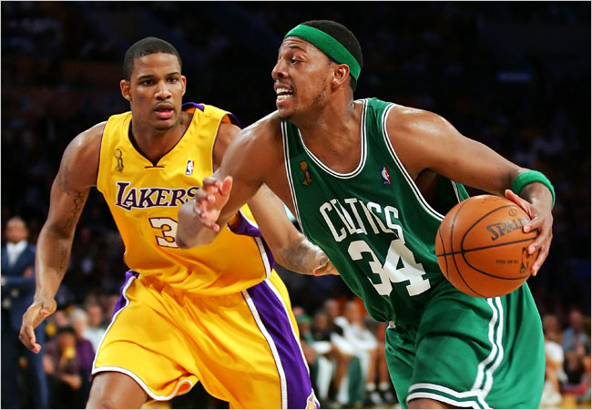
Exercise
The Lakers and the Celtics meet for a 7-game playoff. They play until one team wins four games.
Suppose the Lakers win 60% of the time. What is the probability that all 7 games are played?
Please consider the first 6 games!

Slide 48

Example 3.11 Gambler’s ruin
You have $100. You keep betting $1 on red at roulette.
You stop when you get $200, or when you run out of money.
What is the probability you win $200?

Slide 49
Example 3.11 Gambler’s ruin
Probability model
S = all infinite sequences of Reds and Others
Let R_{i} be the event of red in the ith round (there is an R in position i)
Probabilities:
call this p
P(R₁) = P(R₂) = … = 18/37
R₁, R₂, … are independent

Slide 50
Example 3.11 Gambler’s ruin
$n
You have $100. You stop when you get $200.
Let W be the event you get $200 and w_{n} = P(W).
w_{n} means the probability of W when having $ n
w_{n} = P(W)
= P(W|R₁) P(R₁) + P(W|R₁^{c}) P(R₁^{c})
w_{n+1}
p
w_{n-1}
1-p
w_{n} = (1-p)w_{n-1} + pw_{n+1}
w₀ = 0
w₂₀₀ = 1.

Slide 51
Example 3.11 Gambler’s ruin
w_{n} = (1-p)w_{n-1} + pw_{n+1}
w₀ = 0
w₂₀₀ = 1.
p(w_{n+1} – w_{n} ) = (1-p)(w_{n} – w_{n-1})
let λ = (1-p)/p = 19/18
w_{n+1} – w_{n} = λ (w_{n} – w_{n-1})
= λ² (w_{n-1} – w_{n-2})
= … = λ^{n} (w₁ – w₀)
w_{n+1} = w_{n} + λ^{n}w₁
= w_{n-1} + λ^{n-1}w₁ + λ^{n}w₁
= … = w₁ + λw₁ + … + λ^{n}w₁

Slide 52
Example 3.11 Gambler’s ruin
w_{n} = (1-p)w_{n-1} + pw_{n+1}
You have $100.
w₀ = 0
w₂₀₀ = 1.
You stop when you win
$200 or run out.
λ = (1-p)/p = 19/18
The probability you win is
w_{n+1} = w₁ + … + λ^{n}w₁
w₁₀₀ ≈ 0.0045
= (λ^{n+1} – 1)/(λ – 1)w₁
w₂₀₀ = (λ²⁰⁰ – 1)/(λ – 1)w₁
λ^{n+1} – 1
w_{n+1} =
λ²⁰⁰ – 1

Slide 53
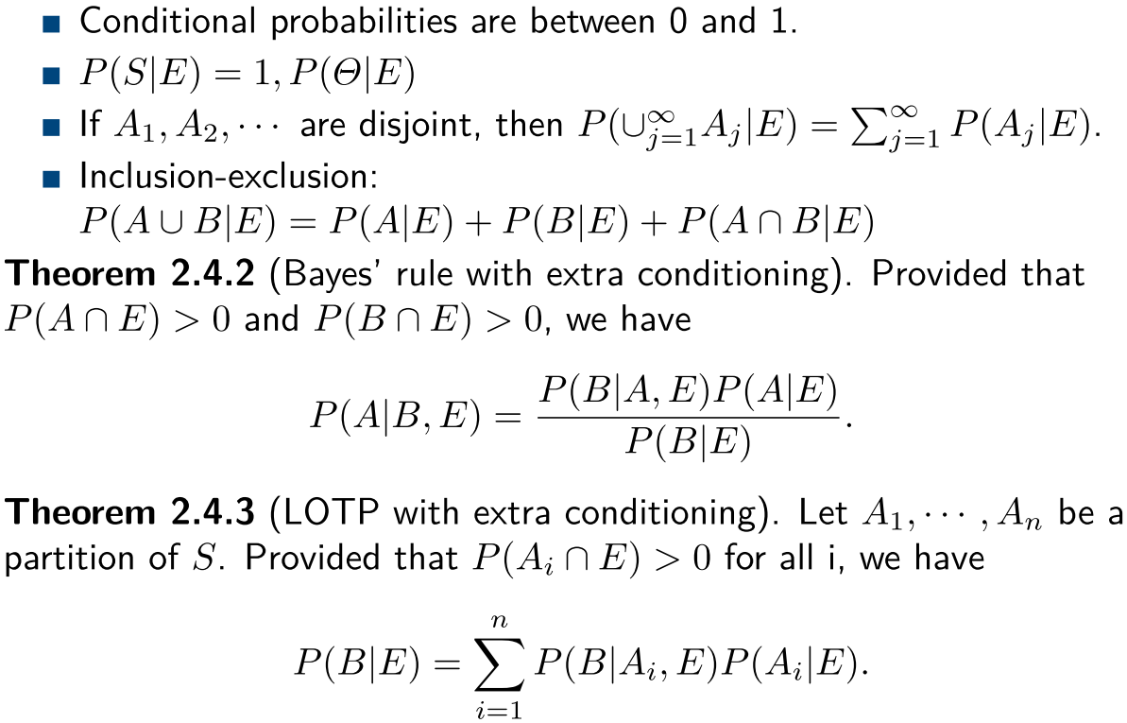
2.4 P(A|F) Is a Probability
Theorem 1
=0
Theorem 2
Theorem 3

Slide 54
Revisit Example 3.6 Medical tests
If you are sick (S), a blood test comes out positive (T) 95% of the time.
If you are not sick, the test is positive 1% of the time.
Suppose 0.5% people in China are sick.
You take the test and come out positive. What are the chances that you are sick?
P(P|T) P(T)
P(S|T) =
≈ 32.3%
P(T|S) P(S) + P(T|S^{c}) P(S^{c})
95% 0.5%
1% 99.5%

Slide 55
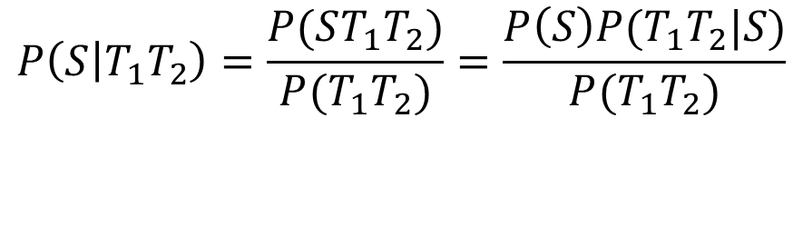
Revisit Example 3.6 Medical tests
If you are sick (S), a blood test comes out positive (T) 95% of the time.
Two tests: T₁, T₂
To compute the probability P(S|T₁T₂)
Solution 1: Directly computing
$$P\left(S | T_{1}T_{2}\right)=\frac{P(ST_{1}T_{2})}{P(T_{1}T_{2})}=\frac{P\left(S\right)P(T_{1}T_{2}|S)}{P(T_{1}T_{2})}$$

Slide 56
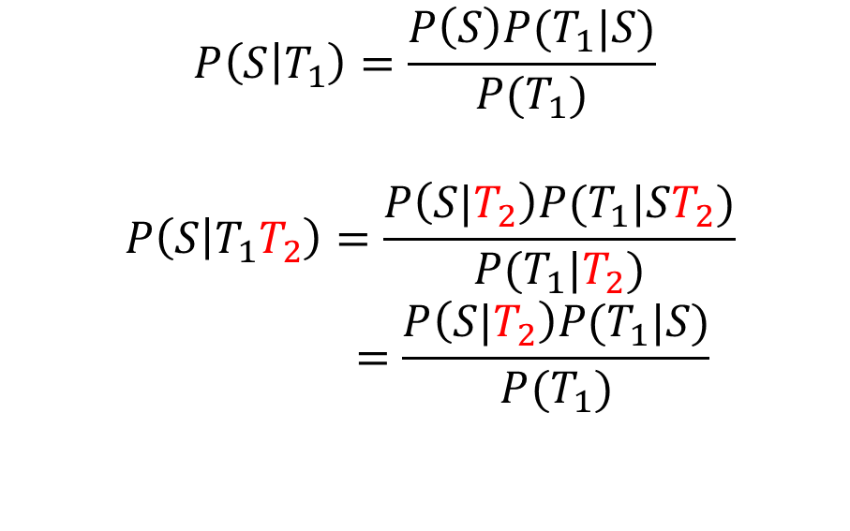
Revisit Example 3.6 Medical tests
If you are sick (S), a blood test comes out positive (T) 95% of the time.
Two tests: T₁, T₂
To compute the probability P(S|T₁T₂)
Solution 2: Bayes’s rules with extra conditions
$$P\left(S | T_{1}\right)=\frac{P\left(S\right)P(T_{1}|S)}{P(T_{1})}$$
$$P\left(S | T_{1}T_{2}\right)=\frac{P\left(S|T_{2}\right)P(T_{1}|ST_{2})}{P(T_{1}|T_{2})}$$
$$=\frac{P\left(S|T_{2}\right)P(T_{1}|S)}{P(T_{1})}$$

Slide 57
Example 3.12
An insurance company that believes that people can be divided into two distinct classes: those who are accident prone and those who are not. During any given year, an accident-prone person will have an accident with probability 0.4, whereas the corresponding figure for a person who is not prone to accidents is 0.2. What is the conditional probability that a new policyholder will have an accident in his or her second year of policy ownership, given that the policyholder has had an accident in the first year?
Notes:
See bayes’ rule exercise

Slide 58
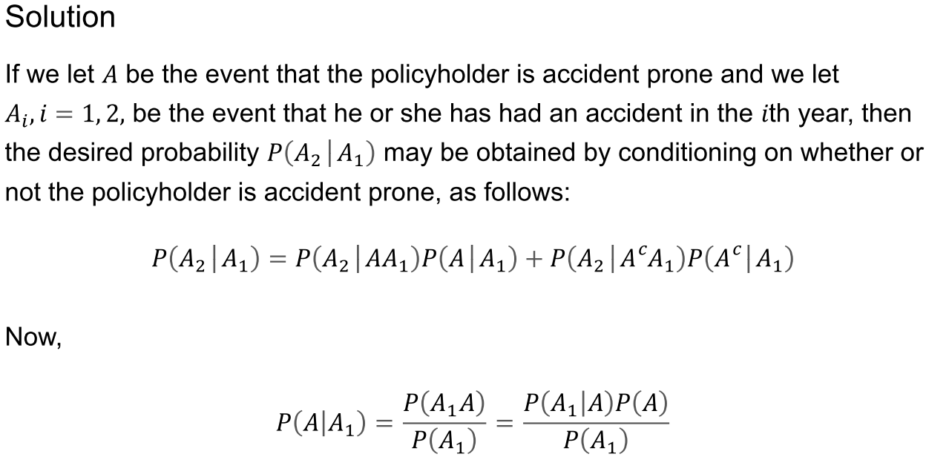
Example 3.12
Notes:
See bayes’ rule exercise

